Slide 1
Programming in C# Language
6th Lecture
Pavel Ježek
pavel.jezek@d3s.mff.cuni.cz
Some of the slides are based on University of Linz .NET presentations.
© University of Linz, Institute for System Software, 2004
published under the Microsoft Curriculum License
(http://www.msdnaa.net/curriculum/license_curriculum.aspx)

Slide 2
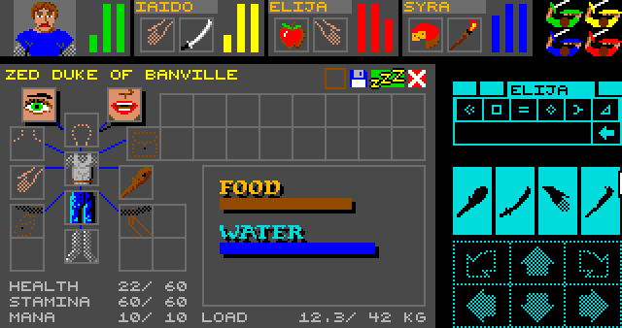
Dungeon Crawler – Implementing Item Slot Types

Slide 3
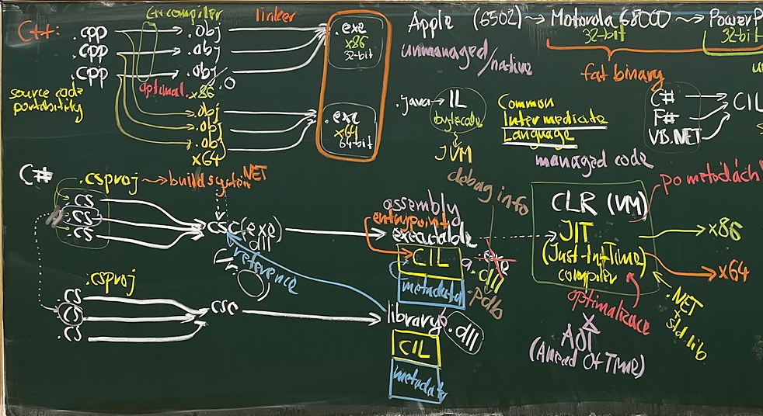
Lecture 04:
C++ compiled N-time for N platforms vs.
C# compiled 1-time for N platforms

Slide 4
Virtual Methods

Slide 5
Virtual Methods: A More Complex Example
class Animal {
public virtual void WhoAreYou() { Console.WriteLine("I am an animal"); }
}
class Mammal : Animal {
public override void WhoAreYou() { Console.WriteLine("I am a mammal"); }
}
class Dog : Mammal {
public new virtual void WhoAreYou() { Console.WriteLine("I am a dog"); }
}
class Beagle : Dog {
public override void WhoAreYou() { Console.WriteLine("I am a beagle"); }
}
Dog pet = new Beagle();
pet.WhoAreYou();
Animal pet = new Beagle();
pet.WhoAreYou();

Slide 6
Virtual Methods: A More Complex Example
class Animal {
public virtual void WhoAreYou() { Console.WriteLine("I am an animal"); }
}
class Mammal : Animal {
public override void WhoAreYou() { Console.WriteLine("I am a mammal"); }
}
class Dog : Mammal {
public new virtual void WhoAreYou() { Console.WriteLine("I am a dog"); }
}
class Beagle : Dog {
public override void WhoAreYou() { Console.WriteLine("I am a beagle"); }
}
Dog pet = new Beagle();
pet.WhoAreYou(); // "I am a beagle"
Animal pet = new Beagle();
pet.WhoAreYou(); // "I am a mammal"

