Slide 1
- This slide is intentionally left blank -
Some of the slides are based on University of Linz .NET presentations.
© University of Linz, Institute for System Software, 2004
published under the Microsoft Curriculum License
(http://www.msdnaa.net/curriculum/license_curriculum.aspx)

Slide 3
FUN WITH C#
EPISODE XIV
GARBAGE COLLECTOR AWAKENS

Slide 4

Maoni Stephens – sole author of .NET GC
Source: https://conf.researchr.org/profile/maonistephens

Slide 5

Maoni Stephens – sole author of .NET GC
Loves cats :)
see Maoni‘s blog: https://devblogs.microsoft.com/dotnet/author/maoni/

Slide 6
 | ...
 | kernel data | ...
 |  | proc table
 |  | B page tbl
 |  | A page tbl
 | kernel code
 | kernel code
 | A stack
 | A stack
 | A’s guard page
 | free
 | free
 | B stack
 | B’s guard page
 | free
 | free
 | free
 | free
 | free
 | free
 | B heap
 | B data
 | B code
 | B code
 | A heap
 | A heap
 | A heap
 | A data
 | A code
A PT | page 0 |  | B PT
CPU (x86/IA-32)
EIP
31 0
ESP
31 0
CR3
31 page table base 0
A’s stack frames
unused A’s stack
B’s stack frames
 | Non-present
 | Kernel/Supervisor
 | User Read/Only
 | User Read/Write

Slide 7
IVT
proc table
...
A’s PT
kernel code
kernel code
A stack
A stack
nothing
free
free | ...
free | 11
free | 10
free | 0F
free | 0E
free | 0D
free | 0C
free | 0B
free | 0A
free | 09
A data | 08
nothing | 07
nothing | 06
nothing | 05
nothing | 04
A code | 03
nothing | 02
A code | 01
nothing | 00
 | kernel data | IVT
 |  | proc table
 |  | ...
 |  | A’s PT
 | kernel code
 | kernel code
 | A stack
 | A stack
 | guard page
 | free
... | free
11 | free
10 | free
0F | free
0E | free
0D | free
0C | free
0B | free
0A | free
09 | free
08 | A data
07 | A data (guard)
06 | A data (guard)
05 | A code (guard)
04 | A code (guard)
03 | A code
02 | A code (guard)
01 | A code
00 | page 0
physical address space (PA)
virtual address space (VA)

Slide 8
IVT
proc table
...
A’s PT
kernel code
kernel code
free
free
free
free
free | ...
free | 11
free | 10
free | 0F
free | 0E
free | 0D
free | 0C
free | 0B
free | 0A
free | 09
free | 08
free | 07
free | 06
free | 05
A stack | 04
A data | 03
A code | 02
A stack | 01
A code | 00
 | kernel data | IVT
 |  | proc table
 |  | ...
 |  | A’s PT
 | kernel code
 | kernel code
 | A stack
 | A stack
 | guard page
 | free
... | free
11 | free
10 | free
0F | free
0E | free
0D | free
0C | free
0B | free
0A | free
09 | free
08 | A data
07 | A data (guard)
06 | A data (guard)
05 | A code (guard)
04 | A code (guard)
03 | A code
02 | A code (guard)
01 | A code
00 | page 0
physical address space (PA)
virtual address space (VA)

Slide 9
 |  | free
 |  | free
 |  | free
 |  | free
 |  | free
 | free
 | free
 | free
 | free
 | free
... | free
11 | free
10 | free
0F | free
0E | free
0D | free
0C | free
0B | free
0A | free
09 | free
08 | free
07 | free
06 | free
05 | free
04 | free
03 | free
02 | free
01 | free
00 | page 0
FW ROM
FW ROM
FW ROM
FW ROM
MM I/O
free
VRAM
VRAM
VRAM
VRAM
VRAM | ...
VRAM | 11
VRAM | 10
free | 0F
free | 0E
free | 0D
free | 0C
free | 0B
B’s PT | 0A
A stack | 09
A data | 08
A code | 07
A stack | 06
A code | 05
A’s PT | 04
proc table | 03
kernel code | 02
kernel code | 01
IVT | 00
 | kernel data | IVT
 |  | proc table
 |  | ctrl regs
 |  | B’s PT
 |  | A’s PT
 | kernel code
 | kernel code
 | A stack
 | A stack
 | guard page
... | free
11 | free
10 | free
0F | free
0E | free
0D | free
0C | free
0B | free
0A | free
09 | free
08 | A data
07 | A data (guard)
06 | A data (guard)
05 | A code (guard)
04 | A code (guard)
03 | A code
02 | A code (guard)
01 | A code
00 | page 0
B’s virtual address space (VA)
physical address space (PA)
A’s virtual address space (VA)

Slide 10
 | kernel data | IVT
 |  | proc table
 |  | ctrl regs
 |  | B’s PT
 |  | A’s PT
 | kernel code
 | kernel code
 | free
 | free
 | free
... | free
11 | free
10 | free
0F | free
0E | free
0D | free
0C | free
0B | free
0A | free
09 | free
08 | free
07 | free
06 | free
05 | free
04 | free
03 | free
02 | free
01 | free
00 | page 0
FW ROM
FW ROM
FW ROM
FW ROM
MM I/O
free
VRAM
VRAM
VRAM
VRAM
VRAM | ...
VRAM | 11
VRAM | 10
free | 0F
free | 0E
free | 0D
free | 0C
free | 0B
B’s PT | 0A
A stack | 09
A data | 08
A code | 07
A stack | 06
A code | 05
A’s PT | 04
proc table | 03
kernel code | 02
kernel code | 01
IVT | 00
 | kernel data | IVT
 |  | proc table
 |  | ctrl regs
 |  | B’s PT
 |  | A’s PT
 | kernel code
 | kernel code
 | A stack
 | A stack
 | guard page
... | free
11 | free
10 | free
0F | free
0E | free
0D | free
0C | free
0B | free
0A | free
09 | free
08 | A data
07 | A data (guard)
06 | A data (guard)
05 | A code (guard)
04 | A code (guard)
03 | A code
02 | A code (guard)
01 | A code
00 | page 0
B’s virtual address space (VA)
physical address space (PA)
A’s virtual address space (VA)

Slide 11
 | kernel data | IVT
 |  | proc table
 |  | ctrl regs
 |  | B’s PT
 |  | A’s PT
 | kernel code
 | kernel code
 | B stack
 | guard page
 | free
... | free
11 | free
10 | free
0F | free
0E | free
0D | free
0C | free
0B | free
0A | free
09 | free
08 | free
07 | free
06 | B heap
05 | B data
04 | B data
03 | B code (guard)
02 | B code
01 | B code
00 | page 0
FW ROM
FW ROM
FW ROM
FW ROM
MM I/O
B data
VRAM
VRAM
VRAM
VRAM
VRAM | ...
VRAM | 11
VRAM | 10
B heap | 0F
B code | 0E
B data | 0D
B stack | 0C
B code | 0B
B’s PT | 0A
A stack | 09
A data | 08
A code | 07
A stack | 06
A code | 05
A’s PT | 04
proc table | 03
kernel code | 02
kernel code | 01
IVT | 00
 | kernel data | IVT
 |  | proc table
 |  | ctrl regs
 |  | B’s PT
 |  | A’s PT
 | kernel code
 | kernel code
 | A stack
 | A stack
 | guard page
... | free
11 | free
10 | free
0F | free
0E | free
0D | free
0C | free
0B | free
0A | free
09 | free
08 | A data
07 | A data (guard)
06 | A data (guard)
05 | A code (guard)
04 | A code (guard)
03 | A code
02 | A code (guard)
01 | A code
00 | page 0
B’s virtual address space (VA)
physical address space (PA)
A’s virtual address space (VA)

Slide 12
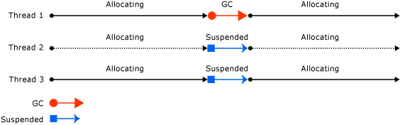
Workstation mode GC
Schema from: https://learn.microsoft.com/en-us/dotnet/standard/garbage-collection/fundamentals

Slide 13
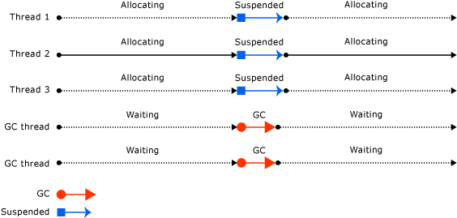
Server mode GC
Schema from: https://learn.microsoft.com/en-us/dotnet/standard/garbage-collection/workstation-server-gc

Slide 14
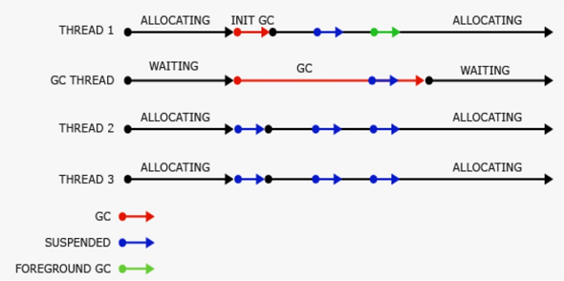
Workstation background/concurrent GC
Schema from: https://learn.microsoft.com/en-us/dotnet/standard/garbage-collection/background-gc

Slide 15
How Would You Implement List<T>.Clear()?
Option | Complexity with Respect to Number of Elements in List (n)
A | O(1)
B | O(n)
C | Something else.

Slide 16
How Would You Implement List<T>.Clear()?
Option | Complexity with Respect to Number of Elements in List (n)
A | O(1)
B | O(n) – set all elements to null! Mind the GC!
C | Something else.

Slide 17
CLI Type Inheritance
System.Object
(C# keyword: object)
pointers
(C#: Type *)
interfaces
(C# keyword: interface)
System.String
(C# keyword: string)
System.Array
System.Delegate
arrays
(C#: Type[] or Type[,])
System.MulticastDelegate
System.ValueType
delegates
(C# keyword: delegate)
user-defined classes
(C# keyword: class)
simple types
System.Int32
(C# keyword: int)
System.Double
(C# keyword: double)
System.Int64
(C# keyword: long)
System.Enum
System.Nullable
(C#: Type?)
user-defined structures
(C# keyword: struct)
System.Boolean
(C# keyword: bool)
…
enumerations
(C# keyword: enum)

Slide 18
Char Literals & Escape Sequences
Char literal: a single character or escape sequence in quotes:
'A' or '\n' or '\x5C'
Escape Sequence | Character | Unicode Code (in hex)
\' | ' | 27
\" | " | 22
\\ | \ | 5C
\0 | Null | 0
\b | Backspace | 8
\n | New line | A
\r | Carriage return | D
\t | Tab (horizontal) | 9
\xWXYZ | Any character | WXYZ
\a | Alert | 7
\f | Form feed | C
\v | Vertical tab | B

Slide 19
What about String.Substring?

Slide 20
- This slide is intentionally left blank -

