Slide 1
Advanced C# Programming 2nd Lecture
Pavel Ježek pavel.jezek@d3s.mff.cuni.cz
Some of the slides are based on University of Linz .NET presentations.
© University of Linz, Institute for System Software, 2004
published under the Microsoft Curriculum License
(http://www.msdnaa.net/curriculum/license_curriculum.aspx)

Slide 2
Method Overloading

Slide 3
Method Overloading
Search:
1) By arity
2A) Not found? Move to upper context and repeat 1)
2B) Found? By type

Slide 4
Crossing Value/Reference Type Boundary
System.Object (C# keyword: object)
pointers (C#: Type *)
interfaces (C# keyword: interface)
System.String (C# keyword: string)
System.Array
System.Delegate
arrays (C#: Type[] or Type[,])
System.MulticastDelegate
System.ValueType
delegates (C# keyword: delegate)
user-defined classes (C# keyword: class)
un/boxing
un/boxing
simple types
un/boxing
System.Int32 (C# keyword: int)
System.Double (C# keyword: double)
System.Int64 (C# keyword: long)
System.Enum
System.Nullable (C#: Type?)
user-defined structures (C# keyword: struct)
System.Boolean (C# keyword: bool)
un/boxing
…
enumerations (C# keyword: enum)

Slide 5
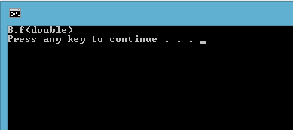
Method Overloading and Fragile Base Class
using System;
public class A {
public void f(int i) {
Console.WriteLine("A.f(int)");
}
}
public class B : A {
public void f(double d) {
Console.WriteLine("B.f(double)");
}
public void Test() {
f(1);
}
}
class Program {
static void Main(string[] args) {
B b = new B();
b.Test();
}
}
Why?

