Slide 1
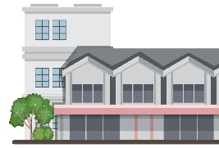
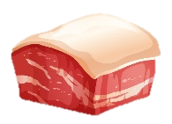
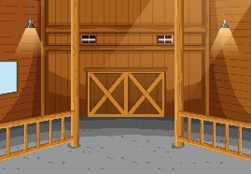
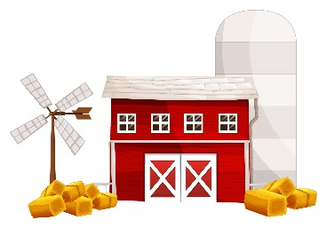
FastFoodRegularPork.csproj
building restaurant
FastFood
hiring oompa loompas
cooking
HamburgerPatty
MeatProcessingPlant
grinding meat
Pork
building pig pen
hamburger
PigProducer
feeding pigs
Corn
CropFarmer
Images by brgfx & topntp26 & macrovector & Smashicons
https://www.freepik.com/author/brgfx
https://www.freepik.com/author/topntp26
https://www.freepik.com/author/macrovector
https://www.flaticon.com/free-icons/mincer

Slide 2
FastFoodFuturePork.csproj
Completed
?
building restaurant
waiting
cooking
FastFood
future HamburgerPatty
Completed
future HamburgerPatty
hiring oompa loompas
promise
promise
grinding meat
.SetResult()
?
waiting
future Pork
Completed
MeatProcessingPlant
future Pork
promise
building pig pen
promise
.SetResult()
hamburger
?
PigProducer
feeding pigs
Completed
Completed
future Corn
future Corn
Task.FromResult<>()
CropFarmer
Images by brgfx & topntp26 & macrovector & Smashicons
https://www.freepik.com/author/brgfx
https://www.freepik.com/author/topntp26
https://www.freepik.com/author/macrovector
https://www.flaticon.com/free-icons/mincer

Slide 3
TaskContinuationOptions
.OnlyOnCanceled
.OnlyOnFaulted
.OnlyOnRanToCompletion
.NotOnCanceled
.NotOnFaulted
.NotOnRanToCompletion

Slide 4
SemaphoreSlim
+ .CurrentCount { get; }
+ constructor SemaphoreSlim(int initialCount)
-> .CurrentCount = initialCount
+ .Wait() BLOCKING -> .CurrentCount -= 1
+ .Release() -> .CurrentCount += 1

